Slide 1



Summer Students Course
2017
Danilo Piparo, Enric Tejedor, Olivier Couet
CERN EP-SFT

Slide 2
This Course
This is an introductory ROOT Workshop.
Objectives:
Become familiar with the ROOT toolkit
Be able to use the C++ prompt and run ROOT macros
Plot and fit data
Perform basic I/O operations
Go parallel with ROOT
Format:
Slides treating the most important concepts
Hands on exercises proposed during the exposition

Slide 3

This Tutorial
These slides are supported by the “ROOT Primer”
Introductory booklet (~60 pages)
Available on the ROOT website (html, epub, pdf): https://root.cern.ch/guides/primer
Code examples can be visualised with the Jupyter Notebooks available at:
http://swan.web.cern.ch/content/root-primer
Signaled with name and the sign:
Two release series of ROOT are available: ROOT5 and ROOT6
This lecture refers to ROOT6, version 6.10

Slide 4
How Can I Run ROOT?
You can choose between three options:
Local ROOT installation
https://root.cern.ch/downloading-root
Lxplus node
https://github.com/root-project/training/blob/master/2017/lxplus.md
SWAN
No installation needed: only a web browser
Preparation: log into CERNBox at https://cernbox.cern.ch
Access SWAN service at https://swan.cern.ch

Slide 5
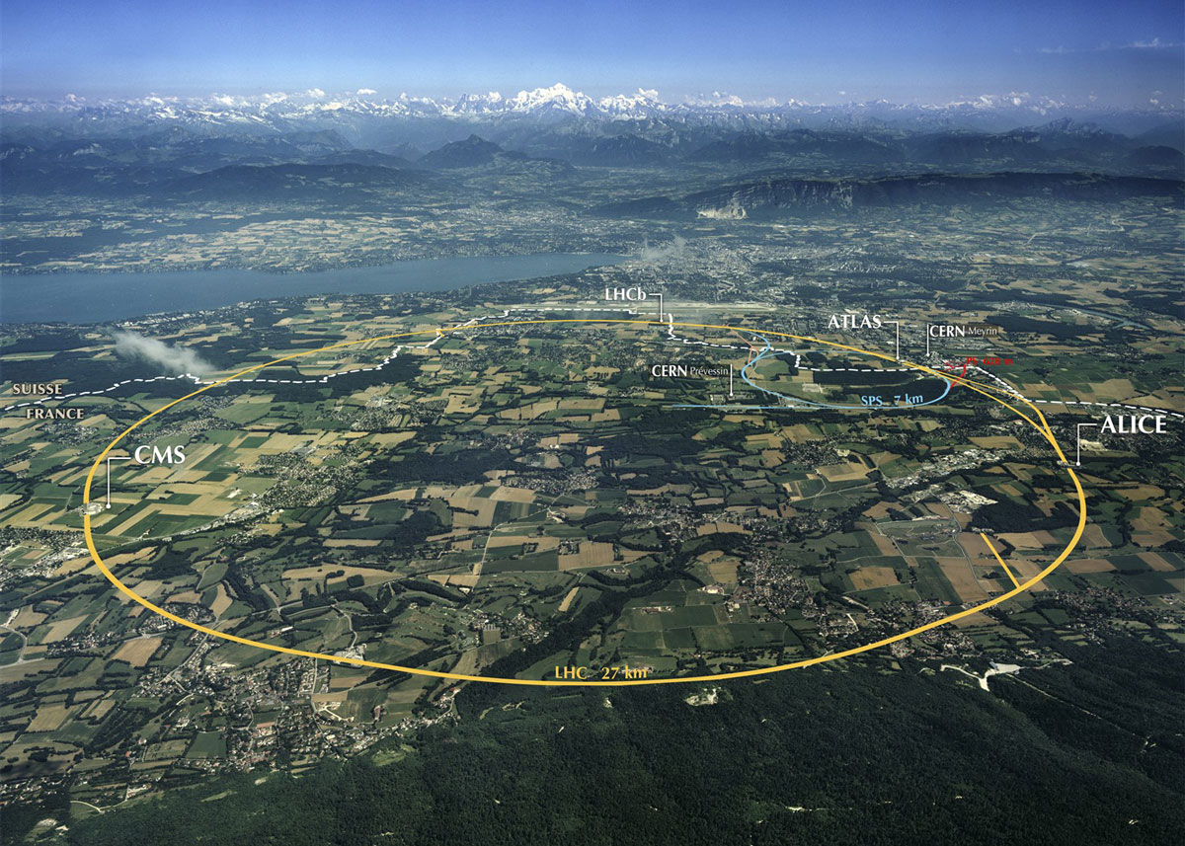
A “Quick Tour” Of ROOT

Slide 6
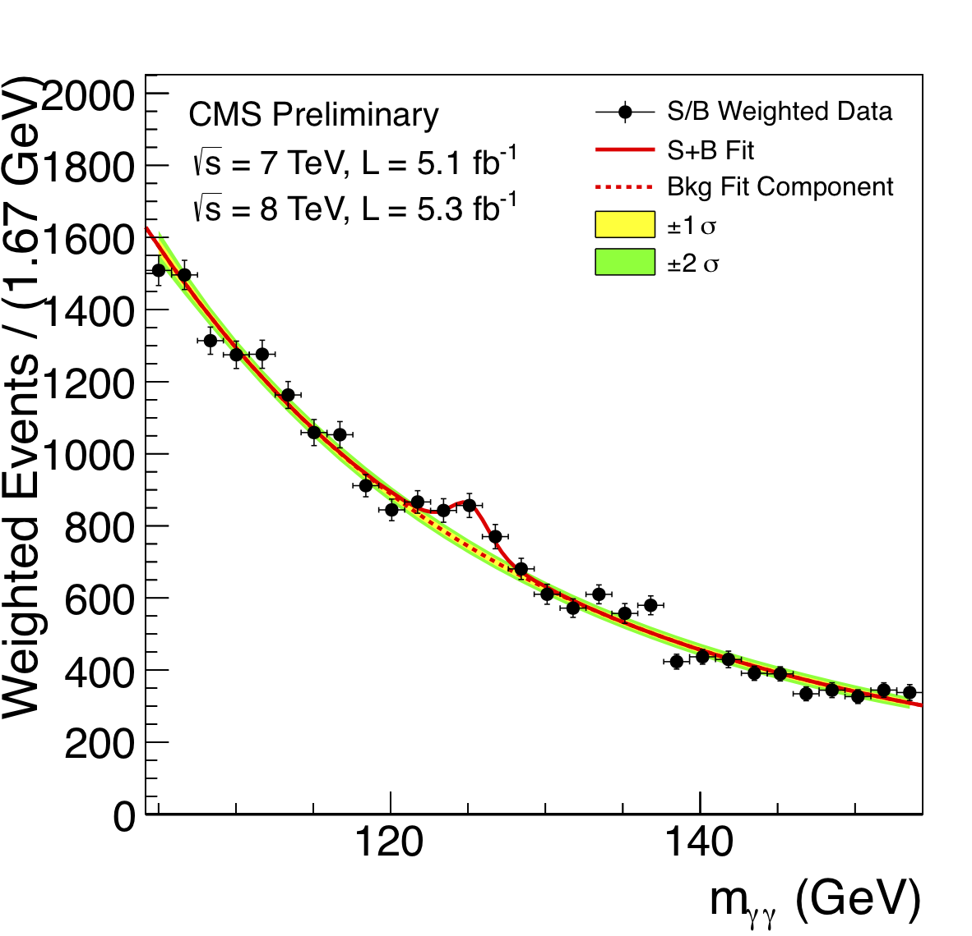
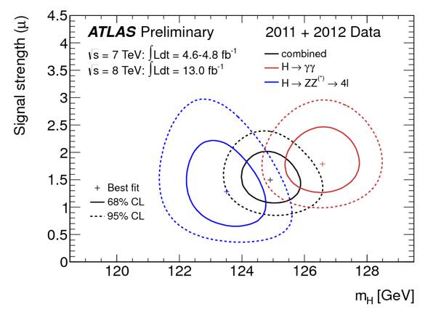
What can you do with ROOT?
LHC collision in CMS:
event display, also done with ROOT!

Slide 7

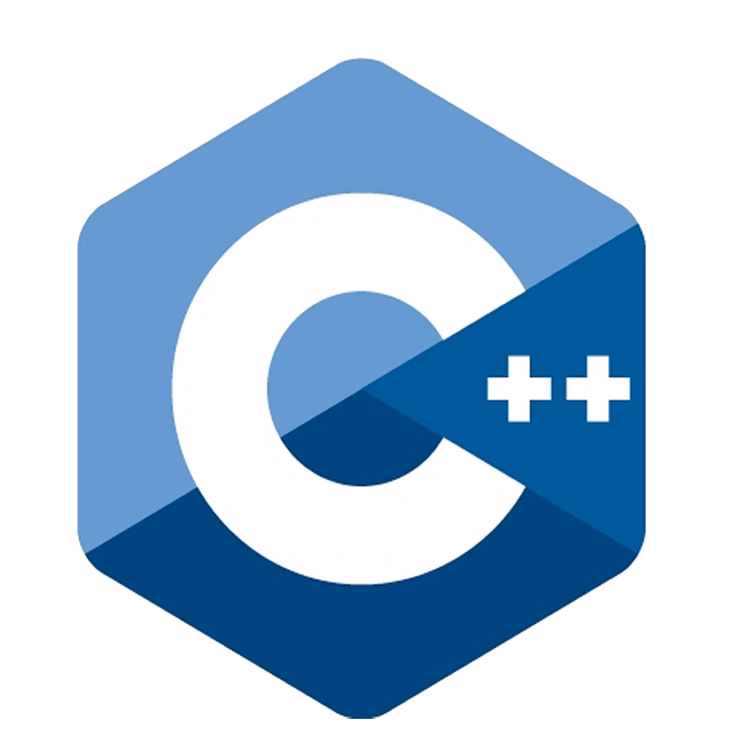


ROOT in a Nutshell
ROOT is a software toolkit which provides building blocks for:
Data processing
Data analysis
Data visualisation
Data storage
ROOT is written mainly in C++ (C++11 standard)
Bindings for Python is provided.
Adopted in High Energy Physics and other sciences (but also industry)
~250 PetaBytes of data in ROOT format on the LHC Computing Grid
Fits and parameters’ estimations for discoveries (e.g. the Higgs)
Thousands of ROOT plots in scientific publications
An Open Source Project
We are on github
github.com/root-project
All contributions are warmly welcome!

Slide 8
ROOT in a Nutshell
ROOT can be seen as a collection of building blocks for various activities, like:
Data analysis: histograms, graphs, trees
I/O: row-wise, column-wise storage of any C++ object
Statistical tools (RooFit/RooStats): rich modeling and statistical inference
Math: non trivial functions (e.g. Erf, Bessel), optimised math functions (VDT)
C++ interpretation: fully C++11 compliant
Multivariate Analysis (TMVA): e.g. Boosted decision trees, neural networks
Advanced graphics (2D, 3D, event display).
PROOF: parallel analysis facility
And more: HTTP servering, JavaScript visualisation.

Slide 9
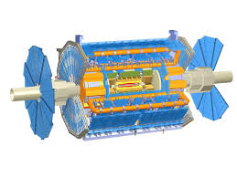
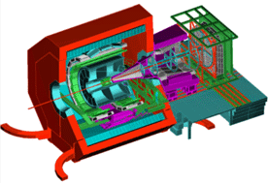
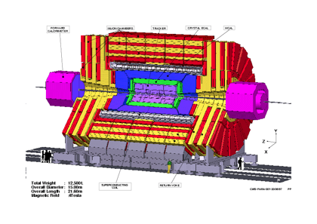
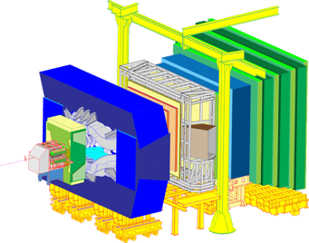
ROOT Application Domains
A selection of the experiments adopting ROOT
Analysis
Offline Processing
Event Selection, statistical treatment …
Further processing, skimming
Reconstruction
Data
Raw
Reco
Analysis
Formats
Images
…
Event Filtering
Data Storage: Local, Network

Slide 10
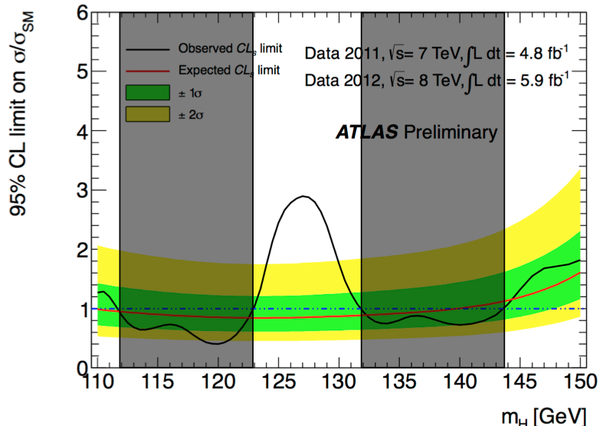
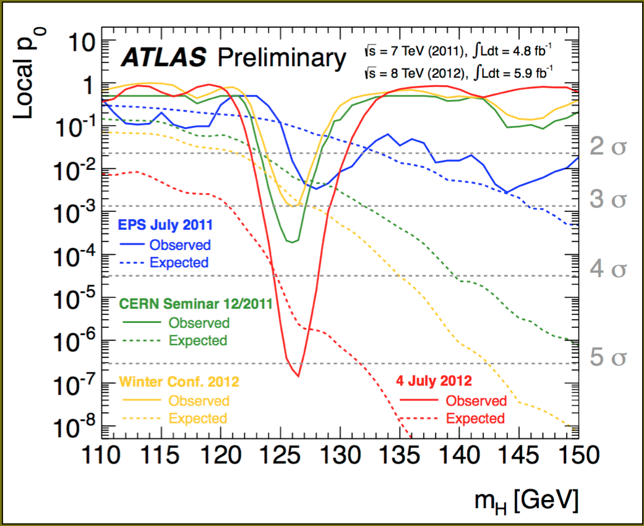
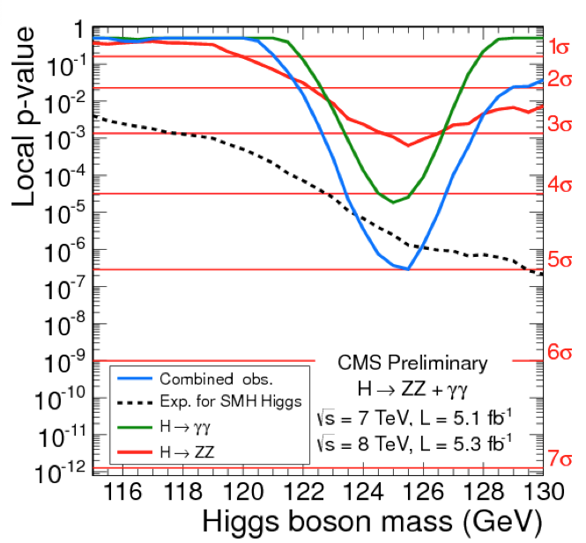
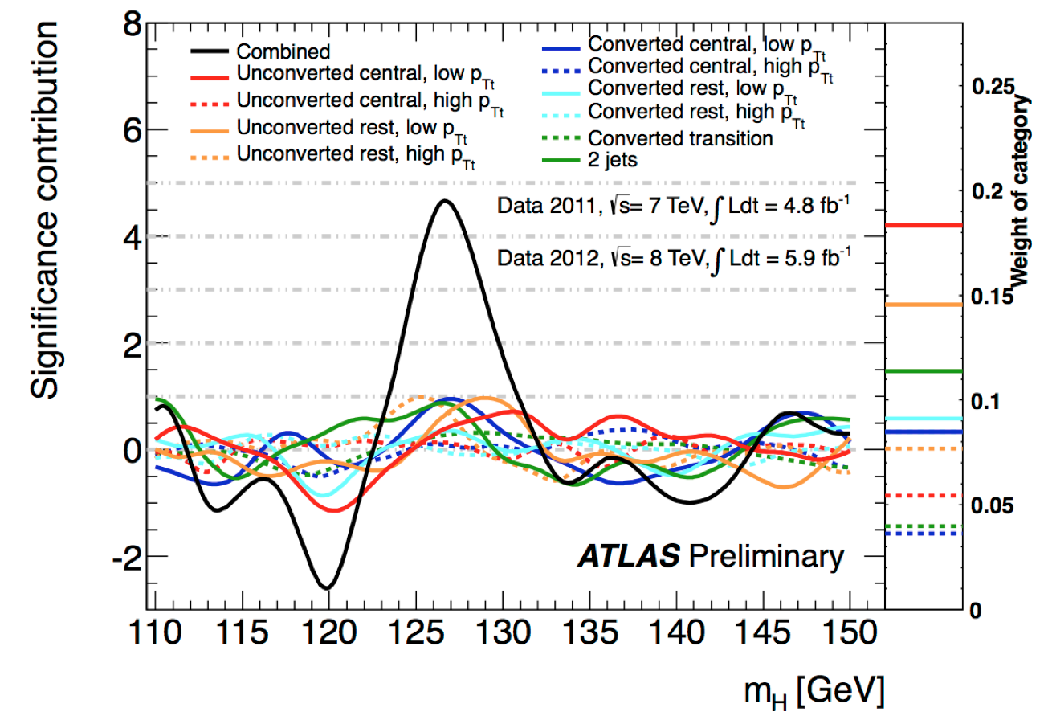
Higgs boson discovery
ATLAS and CMS collaborations were all produced with ROOT !

Slide 11
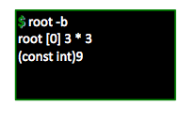
Interpreter
ROOT has a built-in interpreter : CLING
C++ interpretation: highly non trivial and not foreseen by the language !
One of its kind: Just In Time (JIT) compilation
A C++ interactive shell.
Can interpret “macros” (non compiled programs)
Rapid prototyping possible
ROOT provides also Python bindings:
Can use Python interpreter directly after a simple import ROOT
Possible to “mix” the two languages (see more in the following slides)

Slide 12
Persistency (I/O)
ROOT offers the possibility to write C++ objects into files
This is impossible with C++ alone.
Used the LHC detectors to write several petabytes per year.
Achieved with serialization of the objects using the reflection capabilities, ultimately provided by the interpreter
Raw and column-wise streaming
As simple as this for ROOT objects: one method - TObject::Write
Cornerstone for storage of experimental data

Slide 13
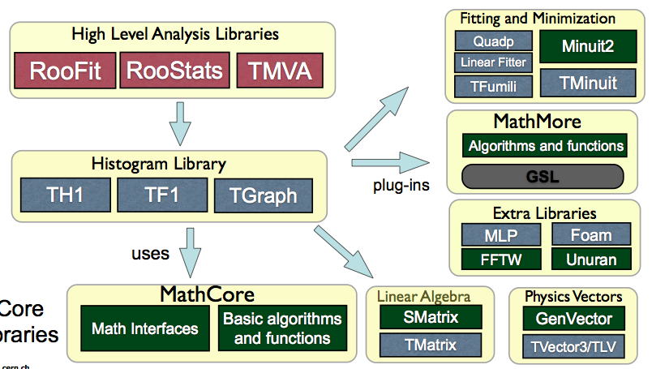
ROOT Math/Stats Libraries
ROOT provides a reach set of mathematical libraries and tools needed for sophisticated statistical data analysis

Slide 14
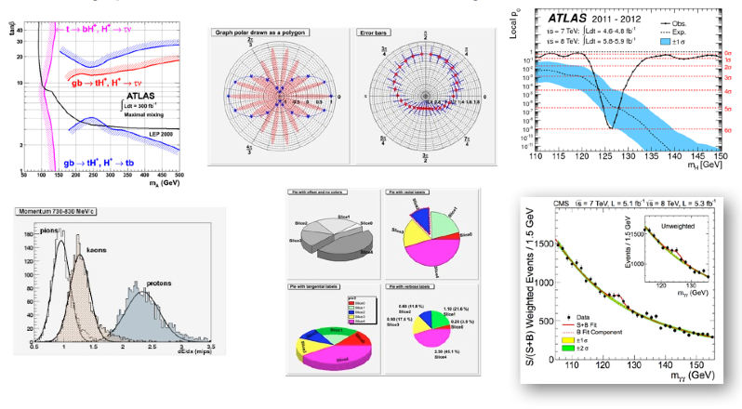
Graphics In ROOT
Many formats for data analysis, and not only, plots

Slide 15
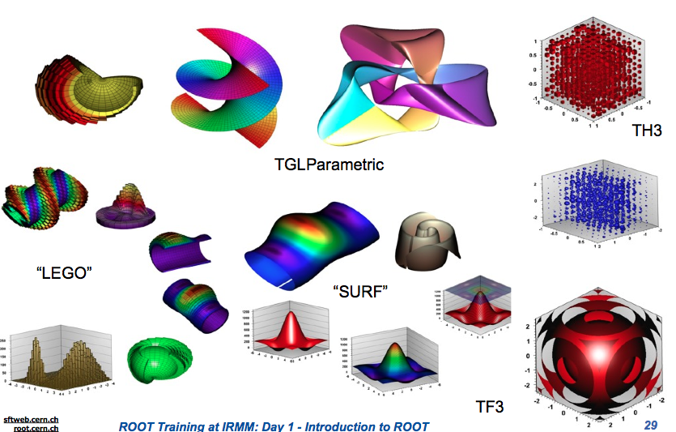
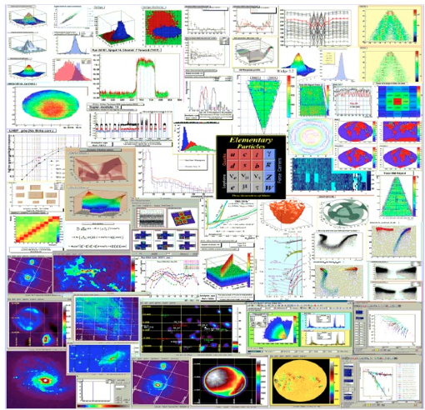
2D and 3D Graphics
Can save graphics in many formats: ps, pdf, svg, jpeg, LaTex, png, c, root …

Slide 16
Parallelism
Hot topic: many ongoing efforts to provide means for parallelisation in ROOT
Explicit paralellism
TThreadExecutor and TProcessExecutor
Protection of resources
Implicit parallelism
TDataFrame: functional chains
TTreeProcessor: process tree events in parallel
TTree::GetEntry: process of tree branches in parallel

Slide 17
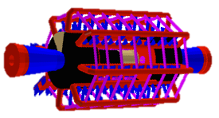
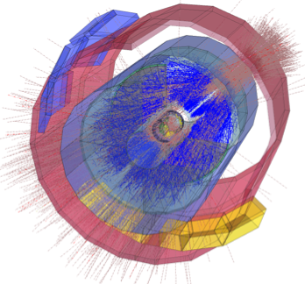
Other ROOT Features
Geometry Toolkit
Represent geometries as complex as LHC detectors
Event Display (EVE)
Visualise particles collisions within detectors

Slide 18




The SWAN Service
Data analysis with ROOT “as a service”
Interface: Jupyter Notebooks
Goals:
Use ROOT only with a web browser
Platform independent ROOT-based data analysis
Calculations, input and results “in the Cloud”
Allow easy sharing of scientific results: plots, data, code
Through your CERNBox
Simplify teaching of data processing and programming
http://swan.web.cern.ch
Notes:
Jupyter notebooks: interactive shell in a browser, like the ROOT prompt but richer (plot embedding, JS)

Slide 19
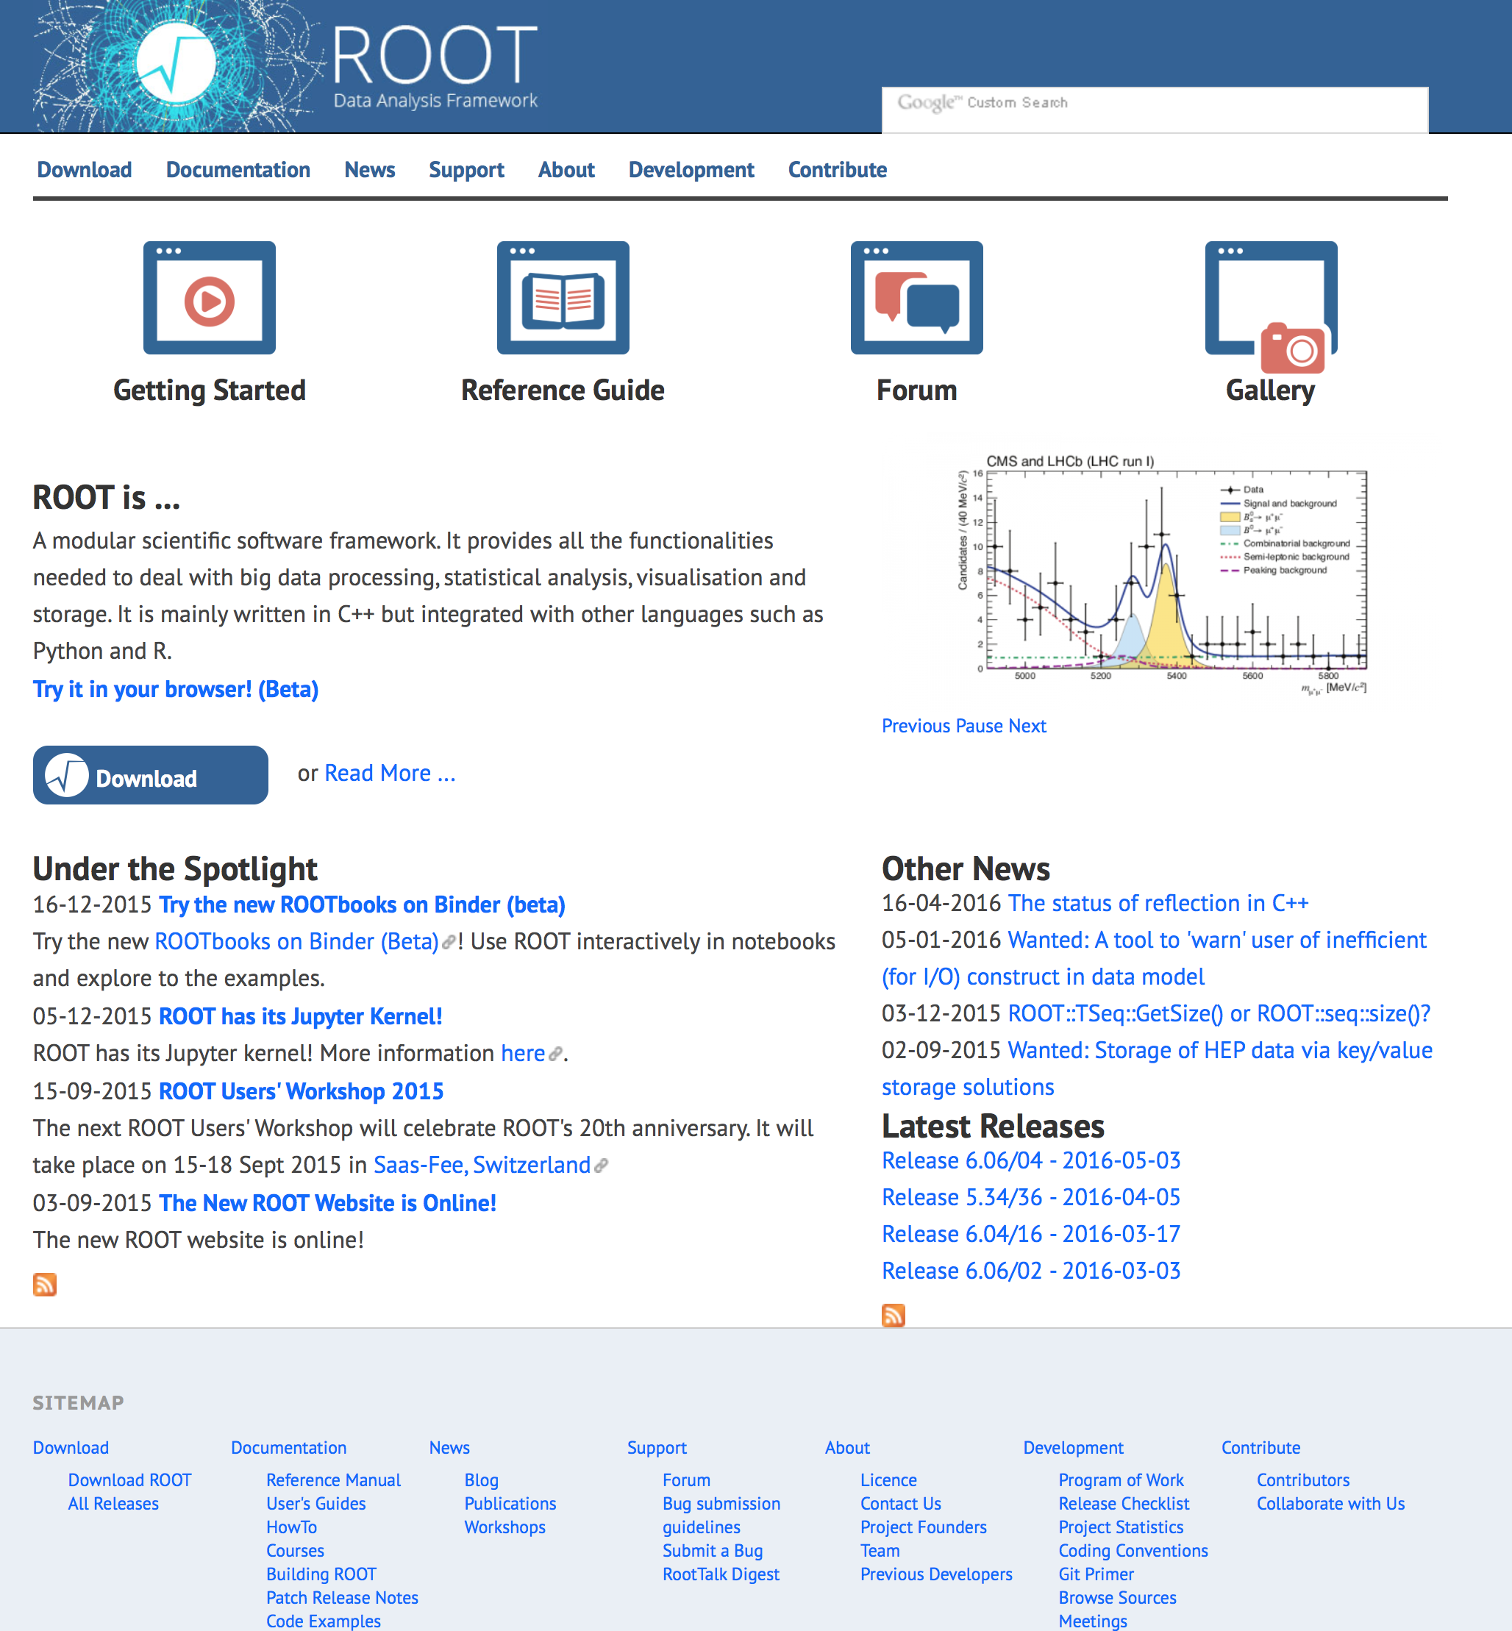
www.root.cern
ROOT web site: the source of information and help for ROOT users
For beginners and experts
Downloads, installation instructions
Documentation of all ROOT classes
Manuals, tutorials, presentations and more
Forum
…

Slide 20
A Few Q/A
? What could be the advantage of learning this software technology ?
! 1. You have all the tools to process, store, analyse and visualise data in one single kit.
! 2. You join a huge users’ community, and a very supportive team of core developers
? Why C++ and not a scripting language ?
! Performance. Support for languages like Python
? Why prompt and libraries instead of a GUI ?
! ROOT is a programming framework, not an office suite.

Slide 21

C++ From 10.000 Km

Slide 22
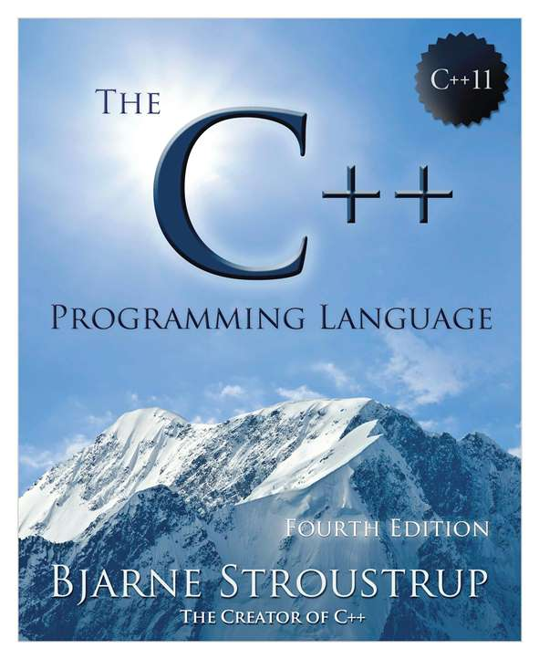
C++ From 10.000 Km
Compiled, strongly typed language, allows to get the best performances from the hardware
Allows object orientation
Templates
Explicit memory management (pointers)
Main language of HEP (together with Python)
In the 90s nearly all legacy FORTRAN HEP code has been migrated to C++
Reduce costs of management of large codebases (millions of lines of code)
Allow groups of hundreds of active developers

Slide 23
Some Useful Terms
A “class” is an entity which encapsulate “data” and “actions” on it
The “data” is represented by the data members (“variables of the class”)
The “actions” are expressed by the class methods (“functions of the class”)
One calls/invokes a method which can have zero or more arguments
An object is an instance of a class
An object is created by a special method, the constructor. There can be more than one constructor, e.g.:
TH1F histo = TH1F(); // default constructor
TH1F histo = TH1F(“histName”, “HistTitle”, 64, 0, 64); // with params
Note: the language is somehow approximate but certainly ok for this lecture

Slide 24
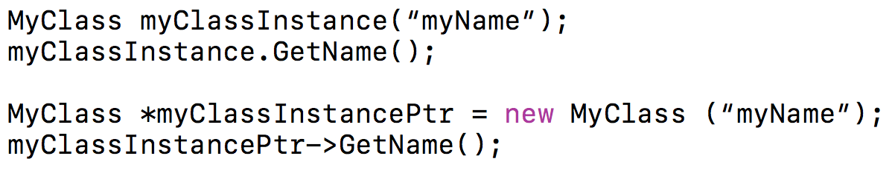
-> and .
The dot and arrow operators are used to access methods and members of objects and pointers to objects
Dot: to access methods and members of objects
Arrow: to access methods and members of pointers to objects
Example:
Note: the language is somehow approximate but certainly ok for this lecture

Slide 25
ROOT Basics
ROOT as a Calculator
ROOT as Function Plotter
Plotting Measurements
Histograms
Interactive ROOT Section

Slide 26

Let’s Fire Up ROOT

Slide 27
The ROOT Prompt
C++ is a compiled language
A compiler is used to translate source code into machine instructions
ROOT provides a C++ interpreter
Interactive C++, without the need of a compiler, like Python, Ruby, Haskell …
Allows reflection (inspect at runtime layout of classes)
Is started with the command:
The interactive shell is also called “ROOT prompt” or “ROOT interactive prompt”
root

Slide 28
ROOT As a Calculator
ROOT interactive prompt can be used as an advanced calculator !
Try it!
root [0] 1+1
(int)2
root [1] 2*(4+2)/12.
(double) 1.00000
root [2] sqrt(3.)
(double) 1.73205
root [3] 1 > 2
(bool) false
ROOT allows not only to type in C++ statements, but also advanced mathematical functions, which live in the TMath namespace.
root [4] TMath::Pi()
(Double_t) 3.14159
root [5] TMath::Erf(.2)
(Double_t) 0.222703

Slide 29
ROOT As a Calculator++
root [6] double x=.5
(double) 5.00000
root [7] int N=30
(int) 30
root [8] double gs=0
(double) 0.00000
Here we make a step forward.
We Declare variables and used a for control structure.
Tab-completion is available. Try it.
root [9] for (int i=0;i<N;++i) gs += TMath::Power(x,i)
root [10] TMath::Abs(gs - (1-TMath::Power(x,N-1))/(1-x))
(Double_t) 1.862645e-09

Slide 30
Interlude: Controlling ROOT
Special commands which are not C++ can be typed at the prompt, they start with a “.”
root [1] .<command>
For example:
To quit root use .q
To issue a shell command use .! <OS_command>
To load a macro use .L <file_name> (see following slides about macros)
.help or .? gives the full list

Slide 31
Exercise
For x values of 0,1,10 and 20 check the difference of the value of a hand-made non-normalised Gaussian and the TMath::Gaus routine.
For one number
root [0] double x=0
root [1] exp(-x*x*.5) – TMath::Gaus(x)
[…]

Slide 32
Exercise Solution
For x values of 0,1,10 and 20 check the difference of the value of a hand-made non-normalised Gaussian and the TMath::Gaus routine.
root [0] double x=0
root [1] exp(-x*x*.5) – TMath::Gaus(x)
[…]
Many possible ways of solving this! E.g:
root [0] for (auto v : {0.,1.,10.,20.}) cout << v << “ ” << exp(-v*v*.5) – TMath::Gaus(v) << endl

Slide 33
ROOT As a Function Plotter
The class TF1 represents one dimensional functions (e.g. f(x) ):
root [0] TF1 f1("f1","sin(x)/x",0.,10.);//name,formula, min, max
root [1] f1.Draw();
An extended version of this example is the definition of a function
with parameters:
root [2] TF1 f2("f2","[0]*sin([1]*x)/x",0.,10.);
root [3] f2.SetParameters(1,1);
root [4] f2.Draw();

Slide 34
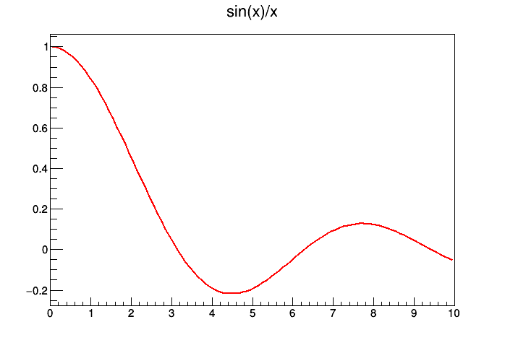
ROOT As a Function Plotter
The class TF1 represents one dimensional functions (e.g. f(x) ):
root [0] TF1 f1("f1","sin(x)/x",0.,10.);//name,formula, min, max
root [1] f1.Draw();
An extended version of this example is the definition of a function
with parameters:
root [2] TF1 f2("f2","[0]*sin([1]*x)/x",0.,10.);
root [3] f2.SetParameters(1,1);
root [4] f2.Draw();

Slide 35
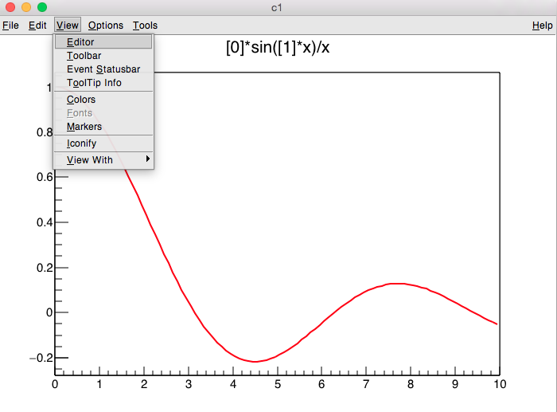
Exercise: Interaction With The Plot

Slide 36
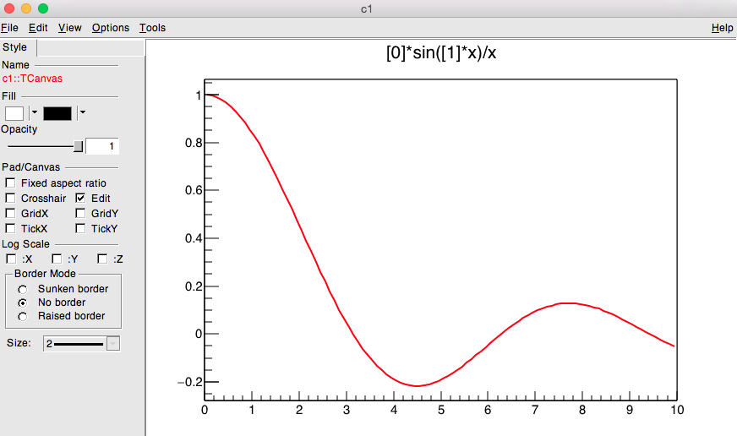
Exercise: Interaction With The Plot

Slide 37
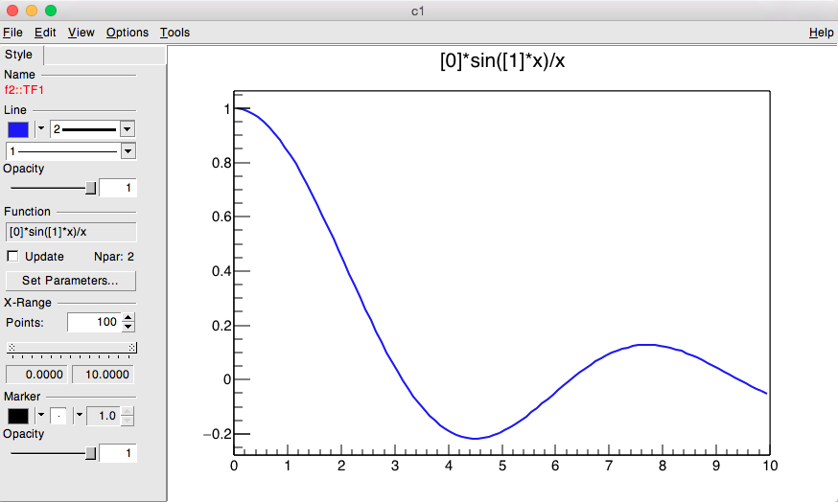
Exercise: Interaction With The Plot
Click on the curve and change colour

Slide 38
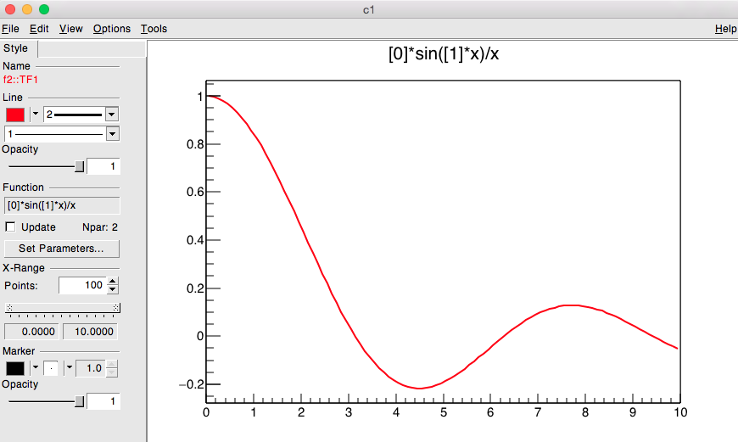
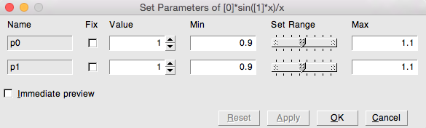
Exercise: Interaction With The Plot
Increment in steps
Set “Immediate preview”

Slide 39
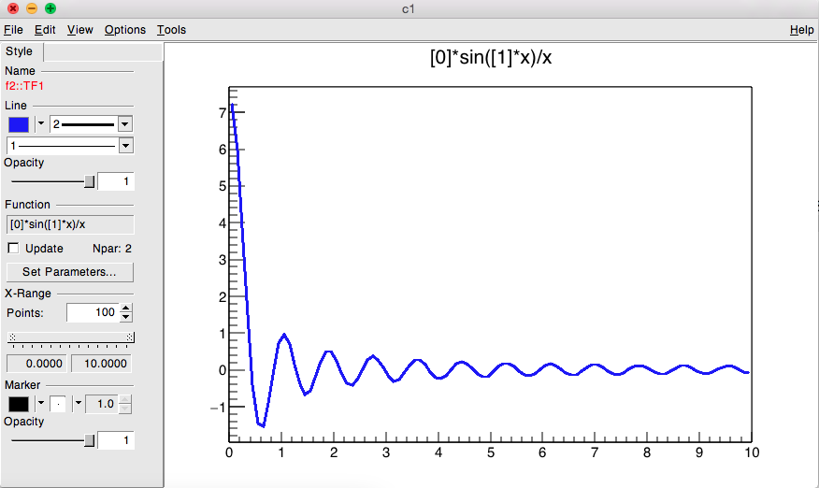
Exercise: Interaction With The Plot

Slide 40
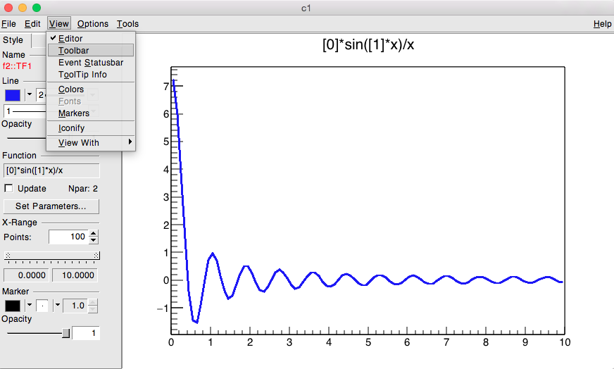
Exercise: Interaction With The Plot

Slide 41
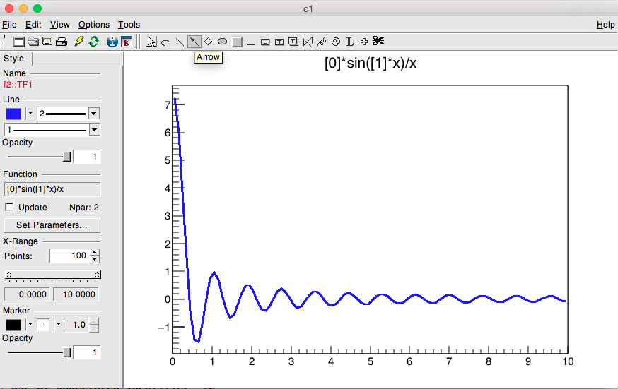
Exercise: Interaction With The Plot

Slide 42
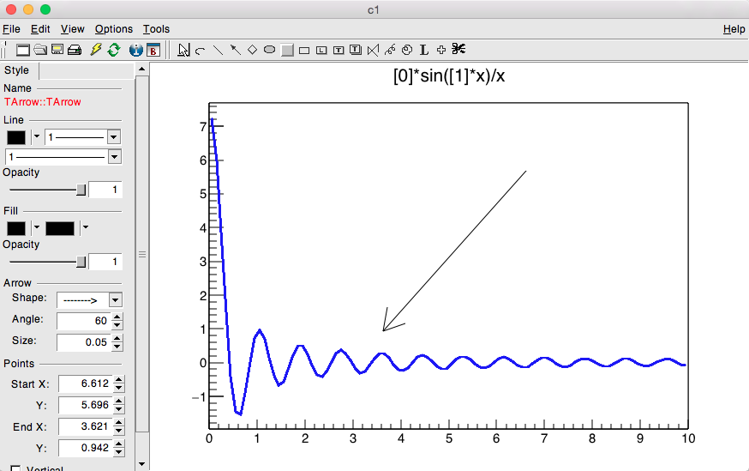
Exercise: Interaction With The Plot

Slide 43
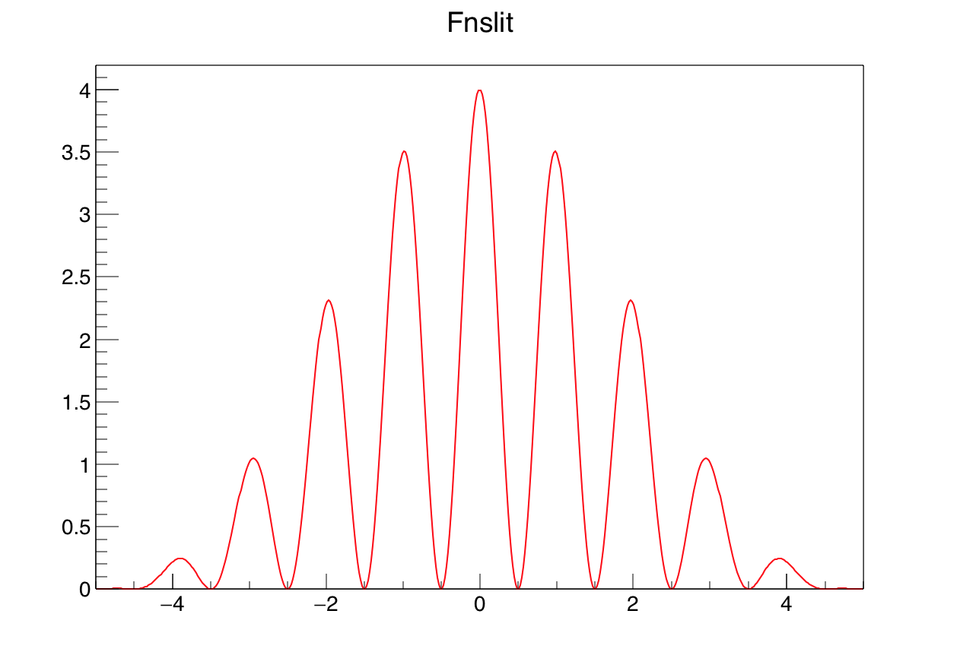
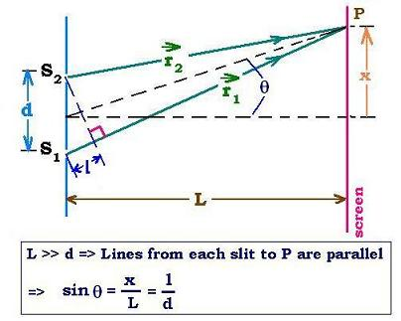
ROOT As a Function Plotter
The example slits.C, detailed in the Primer, is a more complex
C++ program calculating and displaying the interference pattern produced by
light falling on a multiple slit.

Slide 44
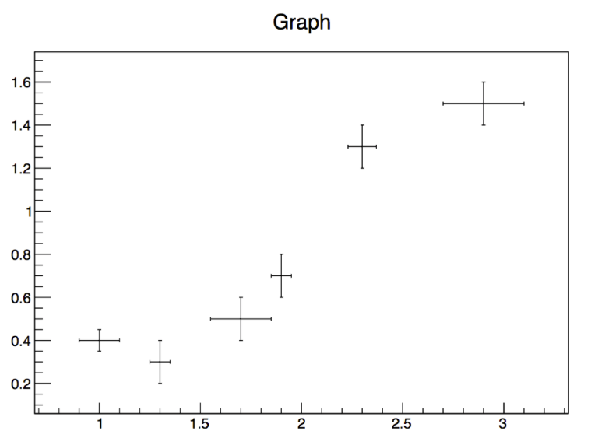
Plotting Measurements
The class TGraphErrors allows to display measurements, including errors, with different types of constructors. In the following example, data are taken from the file ExampleData.txt:
root [0] TGraphErrors gr("ExampleData.txt");
root [1] gr.Draw("AP");
Tells ROOT to draw the Axis and the Points

Slide 45
Exercise: TGraph
Create a graph (TGraph)
Set its title to “My graph”, its X axis title to “myX” and Y axis title to “myY”
Fill it with three points: (1,0), (2,3), (3,4)
Set a red full square marker
Draw a orange line between points

Slide 46
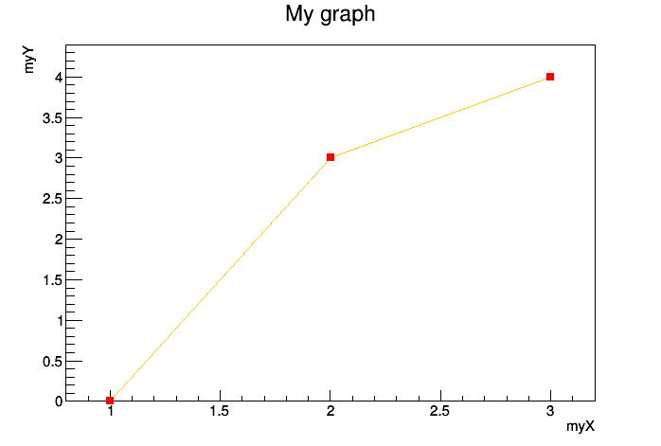
Exercise Solution
root [0] TGraph g
root [1] g.SetTitle("My graph;myX;myY")
root [2] g.SetPoint(0,1,0)
root [3] g.SetPoint(1,2,3)
root [4] g.SetPoint(2,3,4)
root [5] g.SetMarkerStyle(kFullSquare)
root [6] g.SetMarkerColor(kRed)
root [7] g.SetLineColor(kOrange)
root [8] g.Draw("APL")

Slide 47
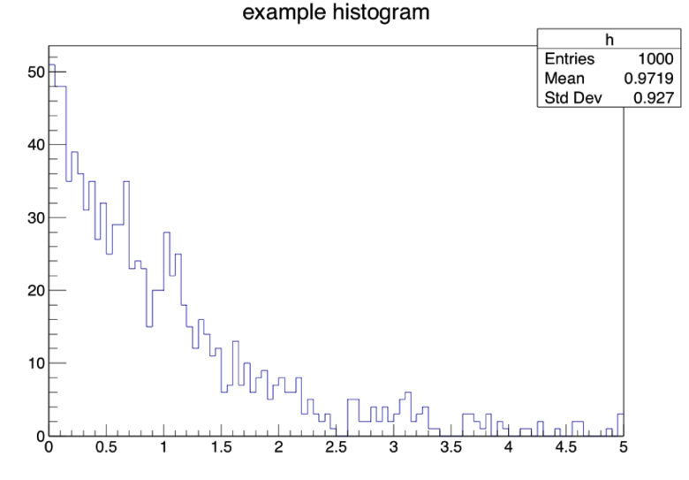
Histograms
The TH* classes represent histograms
TH1* are monodimensional, TH2* are bidimensional …
The final letter describes the type stored in each bin:
A double in TH1D, a float in TH1F …
root [0] TF1 efunc("efunc","exp([0]+[1]*x)",0.,5.)
root [1] efunc.SetParameters(1,-1)
root [2] TH1F h("h","hist",100,0.,5.)
root [3] for (int i=0;i<1000;i++) h.Fill(efunc.GetRandom())
root [4] h.Draw()

Slide 48
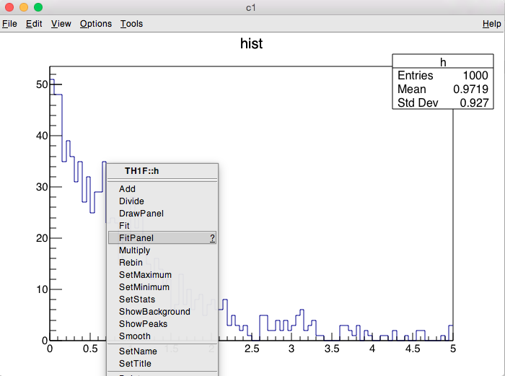
Exercise: Fitpanel
Click on the histogram “line”

Slide 49
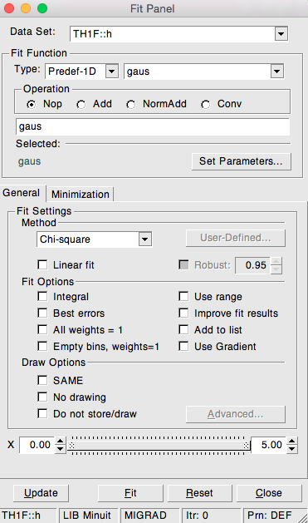
Exercise: Fitpanel
Fit!

Slide 50
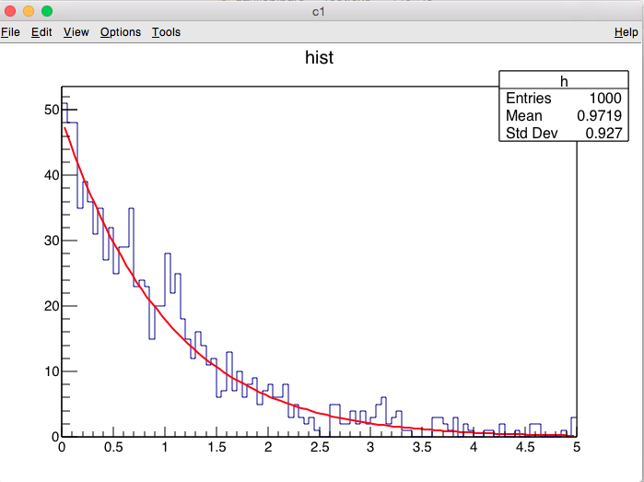
Exercise: Fitpanel

Slide 51
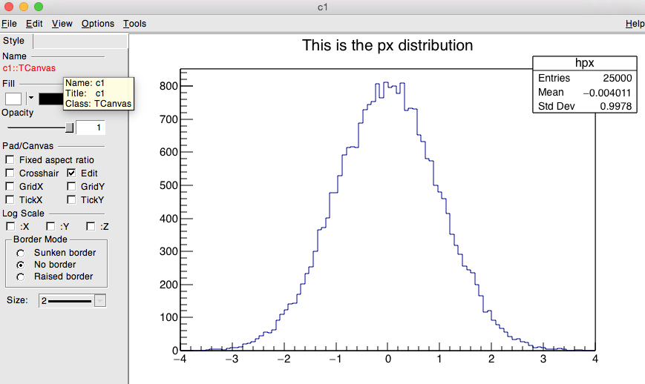
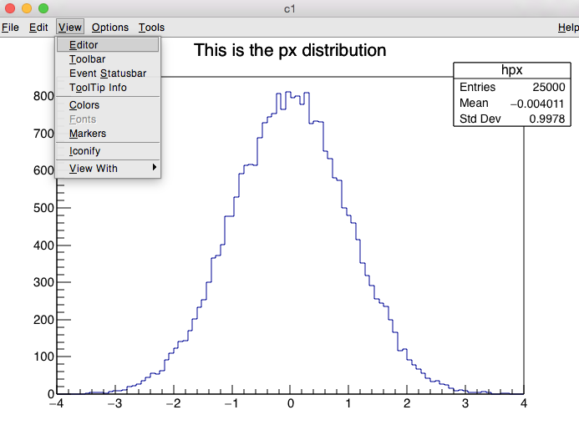
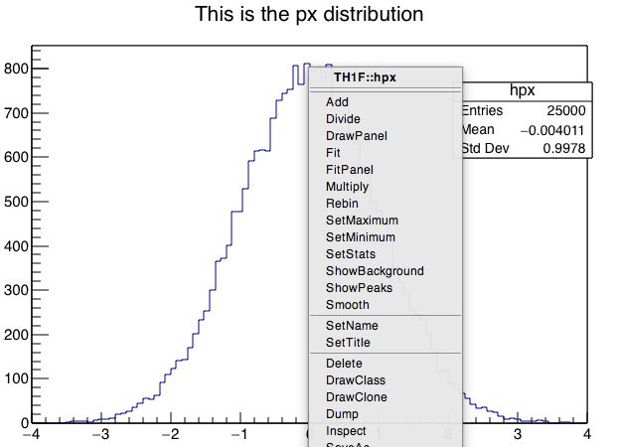
Interactive ROOT
Look at one of your plots again and move the mouse across.
You will notice that this is much more than a static picture.
Try to interact with objects and manipulate them.

Slide 52
Summary of Visual Effects
Colours and Graph Markers: To specify a colour, some identifiers like kWhite, kRed or kBlue can be used for markers, lines, arrows etc. The complete summary of colours is represented by the ROOT “colour wheel”. ROOT provides several graphics markers like triangles, crosses or stars.
Arrows and Lines: The class representing arrows is TArrow, which inherits from TLine. The constructors of lines and arrows always contain the coordinates of the endpoints.
Text: A possibility to add text in plots is provided by the TLatex class. Latex mathematical symbols are automatically interpreted, you just need to replace the “\” by a “#”.

Slide 53
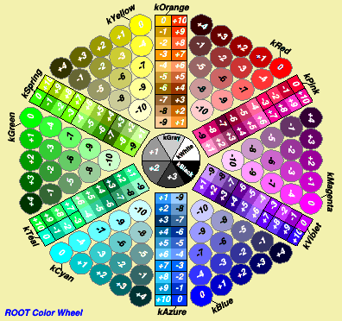
TColorWheel

Slide 54
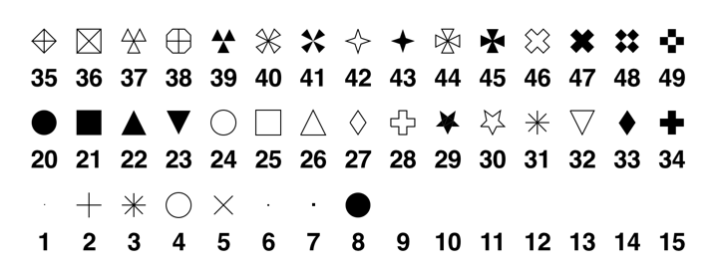
The Family of Markers
kDot=1, kPlus, kStar, kCircle=4, kMultiply=5,
kFullDotSmall=6, kFullDotMedium=7, kFullDotLarge=8,
kFullCircle=20, kFullSquare=21, kFullTriangleUp=22,
kFullTriangleDown=23, kOpenCircle=24, kOpenSquare=25,
kOpenTriangleUp=26, kOpenDiamond=27, kOpenCross=28,
kFullStar=29, kOpenStar=30, kOpenTriangleDown=32,
kFullDiamond=33, kFullCross=34 etc…
Also available through more friendly names ☺

Slide 55
Break

Slide 56
ROOT Macros
General Remarks
A more complete example
Summary of Visual effects
Interpretation and Compilation

Slide 57
General Remarks
We have seen how to interactively type lines at the prompt.
The next step is to write “ROOT Macros” – lightweight programs
The general structure for a macro stored in file MacroName.C is:
Function, no main, same name as the file
void MacroName() {
< ...
your lines of C++ code
... >
}

Slide 58
Running a Macro
The macro is executed at the system prompt by typing:
> root MacroName.C
or executed at the ROOT prompt using .x:
> root
root [0] .x MacroName.C
or it can be loaded into a ROOT session and then be executed by typing:
root [0].L MacroName.C
root [1] MacroName();

Slide 59
Interpretation and Compilation
We have seen how ROOT interprets and “just in time compiles” code. ROOT also allows to compile code “traditionally”. At the ROOT prompt:
Generate shared library and execute function
root [1] .L macro1.C+
root [2] macro1()
ExampleMacro.C
int main() {
ExampleMacro();
return 0;
}
ROOT libraries can be also used to produce standalone, compiled applications:
> g++ -o ExampleMacro ExampleMacro.C `root-config --cflags --libs`
> ./ExampleMacro

Slide 60
A More Complex Example
The example in section 3.2 of the ROOT primer, is a typical task in data analysis, a macro that constructs a graph with errors, fits a (linear) model to it and saves it as an image.
Let’s inspect it together.

Slide 61
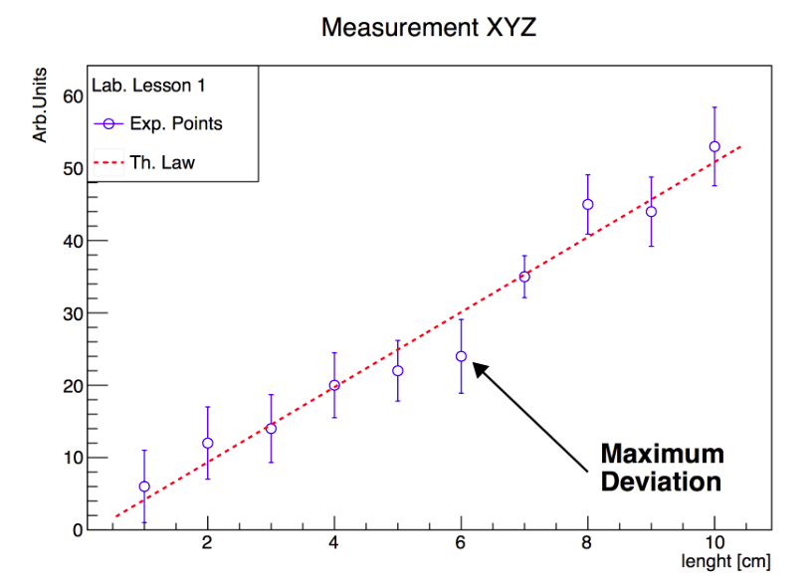
A More Complex Example
And Run it!
> root macro1.C
Macro1_cpp

Slide 62
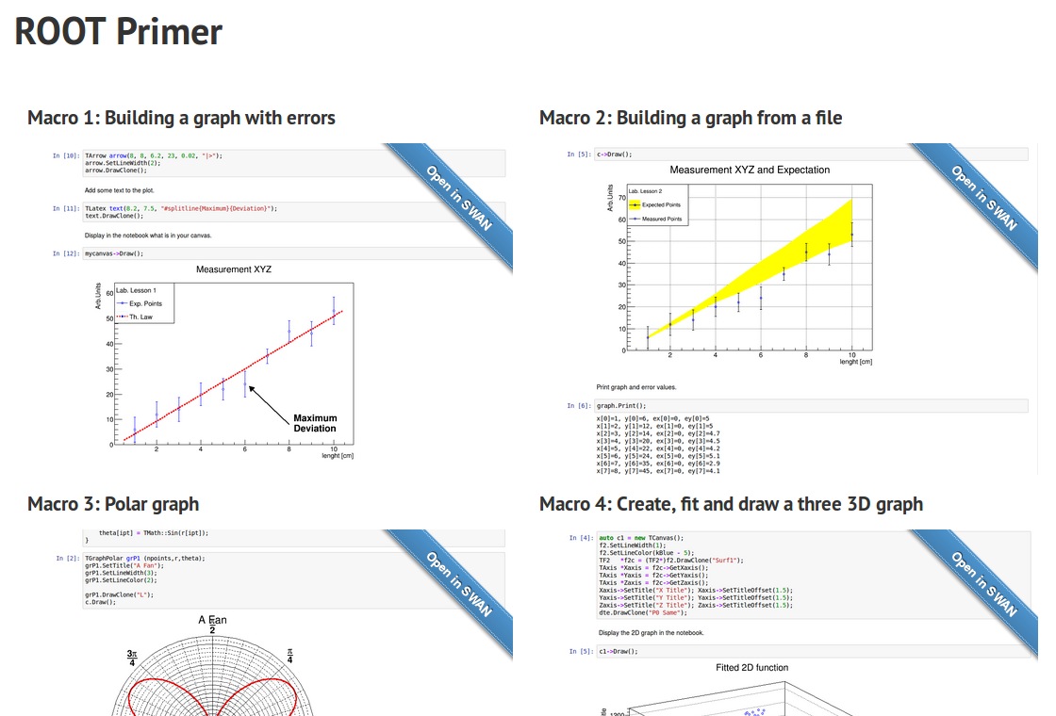

Now Try It in SWAN!
http://swan.web.cern.ch/content/root-primer
Click to open the Macro 1 notebook in SWAN

Slide 63
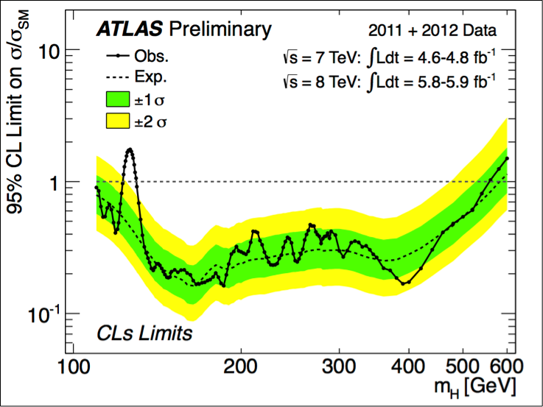
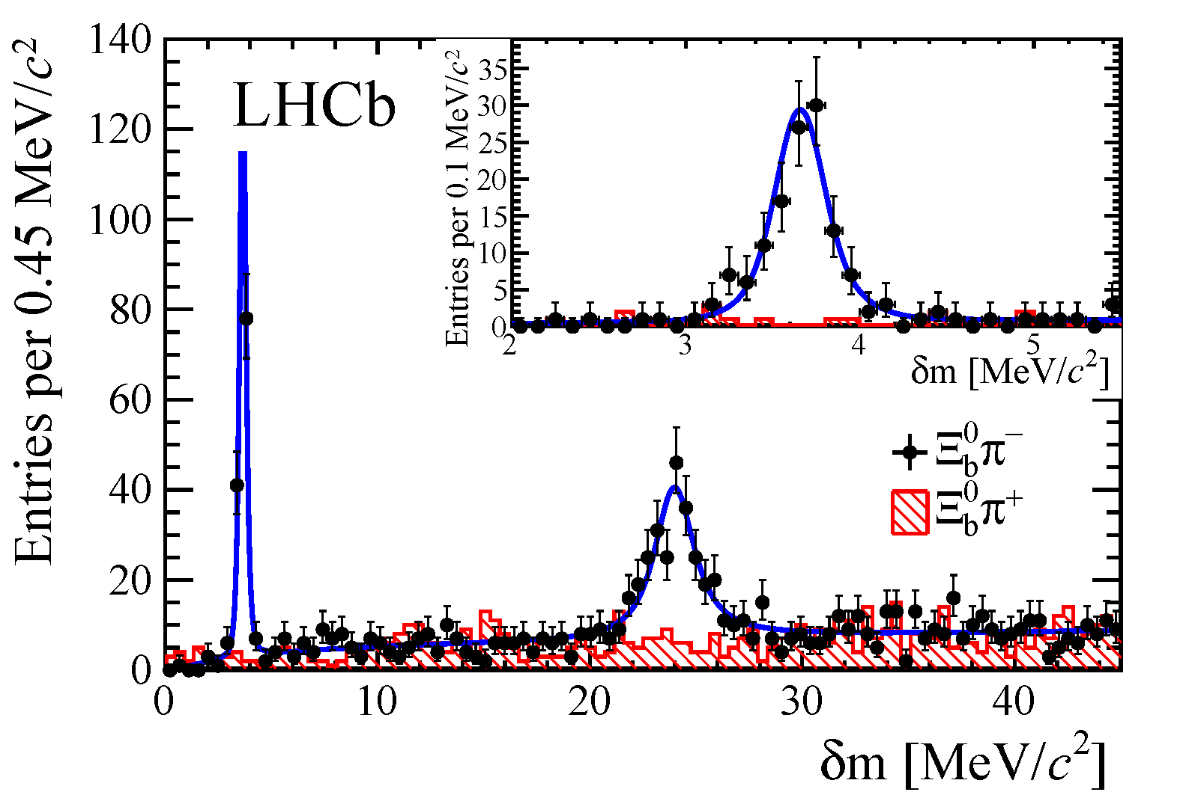
More about Graphs and Histograms

Slide 64
Graphs
Read Graph Points from File
2D Graphs
Also in ROOT primer
Polar Graphs
Multiple graphs

Slide 65
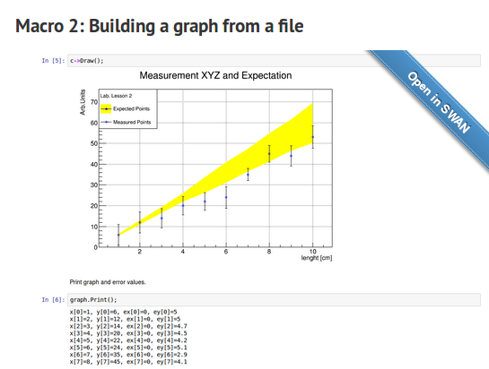
From an ASCII File
To build a graph, experimental data can be read from an ASCII file (i.e. standard text) using this constructor:
Let’s have a look at macro2.C in a notebook
(also in section 4.1 of the Primer).
TGraphErrors(const char *filename,
const char *format="%lg %lg %lg %lg", Option_t *option="");
Macro2_cpp

Slide 66


Polar Graphs
Graphs can also be displayed in polar coordinate like in macro3.C (section 4.2 in the Primer):
Macro3_cpp

Slide 67


2D Graphs
Bi-dimensional graphs can be created in ROOT with the TGraph2DErrors class.
macro4.C, described in Primer’s section 4.3, gives a nice example:
Macro4_cpp

Slide 68


Multiple Graphs
It is sometimes useful to group graphs in a single entity, for instance to compute a common axis system. The class TMultiGraph described in section 4.4 of the Primer allows that.
Multigraph_cpp

Slide 69
Histograms
Your First (in fact second) Histogram
Add and Divide Histograms
Two-dimensional Histograms
Multiple Histograms

Slide 70
Exercise
Write a macro to visualise a Poisson distribution in a histogram
Create a 1D histogram the bins of which are double precision numbers
The max number of counts collected is 15 (max value on the x axis)
Use a random generator to generate 1000 Poissonian counts, mu=4
Properly set the title and axes names, fill the histogram in blue
Fit it, programmatically or with the fit panel (right click on the histogram)
The solution of this exercise is macro5.C shown in section 5.1 in the Primer

Slide 71
Exercise - Optional
Create a macro that draws the sum, difference and ratio of two histograms
Create three pairs of histograms, fill them randomly with normally distributed numbers (TH1::FillRandom(“gaus”))
Divide, sum and subtract them
Useful methods:
TH1::Divide(const TH1*),
TH1::Add(const TH1*, Double_t) the second parameter is a weight
Note: for every plot a different canvas has to be created and before drawing, one has to “cd” into it
TCanvas c; c.cd();
The solution of this exercise is macro6.C shown in section 5.2 in the Primer

Slide 72


Two Dimensional Histograms
Two-dimensional histograms are a very useful tool, for example to inspect correlations between variables, as in the example in section 5.3 of the Primer (macro7.C):

Slide 73


Multiple Histograms
The example in section 5.4 (hstack.C) shows how to group histograms in a single entity call a “stack”
Useful when plotting several backgrounds and a signal
Class THStack
Hstack_cpp

Slide 74
Input and Output
Storing Objects
TTrees and N-tuples

Slide 75
Persistency (I/O)
How does it work?
C++
Classes/structs
Interfaces
(e.g. header files)
Compiler
C++
Dictionary (info for registration of classes in ROOT Core)
Dictionary generation
XML/C++
Selection metadata
(transient members, versioning, morphing)
Shared
Library
C++
Classes/structs
implementations

Slide 76

Persistency (I/O)
How does it work?
Needed, Discovered, Loaded
ROOT Core
Shared
Library
Shared
Library
Shared
Library
Shared
Library
Automatic registration
Now ROOT “knows” how to serialise the instances implemented in the library (series of data members, type, transiency) and to write them on disk in row or column format.

Slide 77
Storing Objects in a File
ROOT allows to store C++ objects on disk (natively the language cannot)
All ROOT objects (inheriting from TObject) can be written on disk via the Write method.
Two ways of storing: row wise (single object dump ) and column wise (N-tuple like storage ).
Feature widely used, e.g. by all LHC experiments

Slide 78

An Example

Slide 79
Exercise
Inspect the content of a file with the TBrowser
Create a file copying the lines of the previous slide at the prompt
Quit the command line interpreter
Boot ROOT opening the file: root my_rootfile.root
Type: TBrowser myBrowser
Inspect the content of the file

Slide 80


Trees
The TTree is the data structure ROOT provides to store large quantities of same types objects
Organised in branches, each one holding objects
Organised in independent events, e.g. collision events
Efficient disk space usage, optimised I/O runtime
Event 1
Event 2
LEP style flat n-tuples evolved in more efficient trees (fast access, read ahead)
Event 3
……..
Event N

Slide 81
Ntuples
The TNtuple is a simplified version of the TTree: store floating point numbers
As powerful for analysis

Slide 82

Example
Primer macro (section 7.2.1)
write_ntuple_to_file.C
write_ntuple_to_file_cpp

Slide 83

Exercise: Potential of the Tree
Run the write_ntuple_to_file.C macro
Open the file in the TBrowser
Create plots clicking on the leaves
Run the code in SWAN
Check your CERNBox for the result file!

Slide 84

Accessing Complex Trees
TTreeReader class: tool to access complex trees in a type-safe manner
Not only floating point numbers as in TNtuple, but all objects!

Slide 85


Accessing the Data
TTreeReader_Example_cpp

Slide 86
TDataFrame
Modern way to interact with columnar data (e.g. TTrees) with a functional approach: avoid all boilerplate code!
Deal with transformations and actions, e.g. filters, creation of new columns and histograms, profiles
Inspired by tools such as Spark and Pandas
Output data in a new file
One line to enable implicit parallelism!
TDataFrame documentation:
https://root.cern/doc/master/classROOT_1_1Experimental_1_1TDataFrame.html
TDataFrame tutorials:
https://root.cern/doc/master/group__tutorial__tdataframe.html
New in version 6.10!

Slide 87



TDataFrame

Slide 88


One Line to Go Parallel
ROOT will parallelise the operations which come afterwards automatically
The runtime ROOT presently leverages to achieve multithreading is TBB.

Slide 89

Cut and Fill Example

Slide 90

Create Columns and Write to Disk

Slide 91

You can Start from Scratch too!

Slide 92
PyROOT
ROOT offers the possibility to interface to Python via a set of bindings called PyROOT
Mix the power of C++ (compiled libraries) and flexibility of Python
Killer application: JIT of C++ code from within Python
Real mix of the two languages
See Primer’s section 8 for more details and TDataFrame tutorials (both in C++ and Python!)
Entry point to use ROOT from within Python:
All classes you now know can be accessed like ROOT.TH1F, ROOT.TGraph, …
import ROOT

Slide 93

Universal Python Bindings

Slide 94
Exercise
Open the Python interpreter (type python)
Import the ROOT module
Create a histogram with 64 bins and a x axis ranging from 0 to 16
Fill it with random numbers distributed according to a linear function (“pol0”)
Change its line width with a thicker one
Draw it!
...or try it in SWAN!
https://swan.cern.ch

Slide 95

Exercise
~> python
>>> import ROOT
>>> h = ROOT.TH1F("myPyHisto","Productivity;Python Knowledge;Productivity",64,0,16)
>>> h.FillRandom("pol1")
>>> h.Draw()

Slide 96



Exercise and examples
FillHistogram_Example_py
TTreeAccess_Example_py

Slide 97
Review of the objectives
Objectives:
Become familiar with the ROOT toolkit
Be able to use the C++ prompt
Plot and fit data
Perform basic I/O operations
Go parallel with ROOT

